Slide 1
9.6 Multiple Bonds
Honors 2019

Slide 2
9.6 Multiple Bonding
The concept of bond orbital hybridization can be extended to other principles of bonding
In covalent bonding, a double bond doesn’t necessarily mean double the density, it means that electrons are interacting in neighboring orbitals
In covalent bonds we have considered thus far (single), electron density is concentrated along the internuclear axis
Internuclear axis – line drawn connecting nuclei of bonded elements

Slide 3
9.6 Sigma Bonding
The head on overlap of orbitals is named sigma (σ) bonding
This type of bonding can result from different types of overlap
In almost every case, sigma bonds are single bonds
Mainly…
s and p orbital
p and p orbital
p and an sp3 orbital

Slide 4
9.6 Pi Bonding (π)
Because each orbital, based on quantum mechanics, can only hold 2 electrons…
We need a different mechanism to describe multiple bonding
In multiple bonding (double, triple) bonding is formed in neighboring elements, overlap occurs between orbitals perpendicular to the internuclear axis
This is known as π bonding
In pi bonding, because overlap is sideways rather than facing each other, total overlap tends to be less than a sigma bond
And are therefore generally weaker than that of sigma bonds

Slide 5
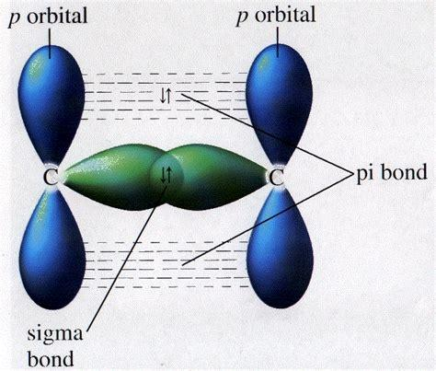
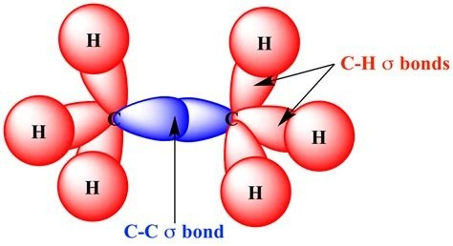
9.6 Sigma vs. Pi Bonding

Slide 6
9.6 Pi Bonding in Ethylene
In determining whether sigma or pi bonding is present, it is very important to consider both molecular geometry and hybridization
Ethylene, or C₂H₄, is a good example of this concept
C₂H₄ has a C=C double bond
C₂H₄ has bond angles (120 degrees) that suggest sp2 hydridization
After hybridization carbon as 1 electron in a sp orbital that is positioned perpendicular to the plane that contains the three sp2 hybrid orbitals
Let’s take a look…

Slide 7
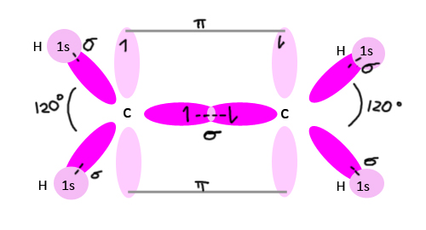
9.6 Pi Bonding in Ethylene

Slide 8
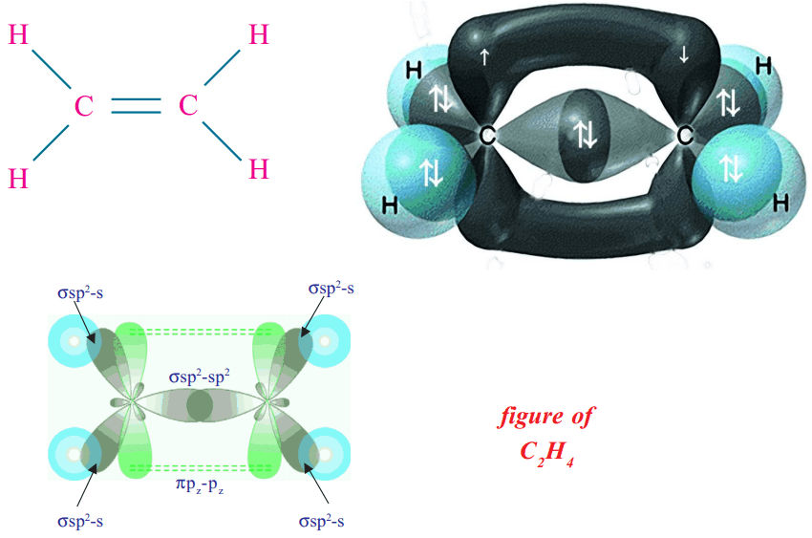
9.6 Pi Bonding in Ethylene

Slide 9
9.6 Support for Pi Bonding
Although we cannot directly observe a pi bond…
First
Pi bonds are shorter than normal single bonds (1.34 A vs 1.54 A)
Second
All 6 elements in ethylene lie in the same plane
Pi bonds need fragments to lie in the same plane for optimal interaction between electrons , otherwise the CH2 fragments would likely not be observed to be planar

Slide 10
9.6 Pi Bonding in Acetylene (Triple)
Pi bonding is also observed in acetylene, or C2H2
The linear geometry of C2H2 suggests that this molecule utilizes sp hybridization
The Lewis structure suggests a triple bond
The carbon atom thus has 2 remaining unhyridized p orbitals
These orbitals are positioned at right angles to each other and the sp orbitals
Let’s take a look….

Slide 11
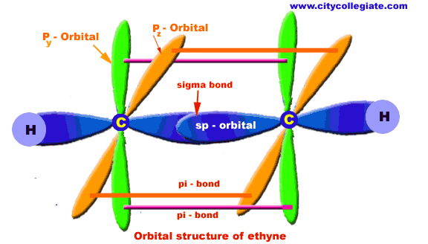
9.6 Pi Bonding in Acetylene (Triple)

Slide 12
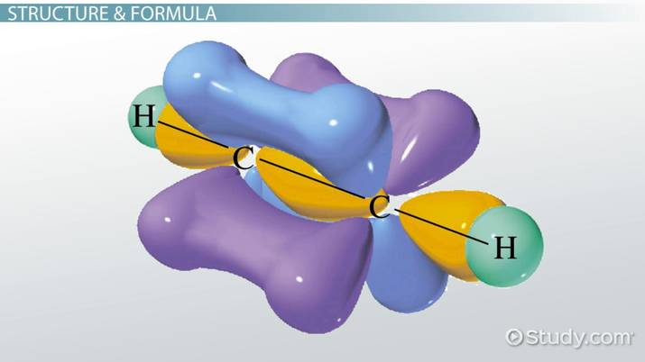
9.6 Pi Bonding in Acetylene (Triple)

Slide 13
9.6 General Conclusions
Every pair of bonded atoms shares one or more pair of electrons
The appropriate set of hybrid orbitals used to form sigma bonds is determined by the geometry of the molecule
Sigma bonds are localized in the region between 2 bonded atoms and do not make a significant contribution to bonding between any other 2 atoms
When atoms share more than one pair of electrons, one pair is utilized in sigma bond, and additional form pi bonds
Electron density in pi bonding occurs above and below the bond axis

